Slide 1
Dynamic programming algorithms for all-pairs shortest path and longest common subsequences
We will study a new technique—dynamic programming algorithms (typically for optimization problems)
Ideas:
  Characterize the structure of an optimal solution
  Recursively define the value of an optimal solution
  Compute the value of an optimal solution in a bottom-up fashion (using matrix to compute)
  Backtracking to construct an optimal solution from computed information.

Slide 2
Floyd-Warshall algorithm for shortest path:
Use a different dynamic-programming formulation to solve the all-pairs shortest-paths problem on a directed graph G=(V,E).
The resulting algorithm, known as the Floyd-Warshall algorithm, runs in O (V³) time.
  negative-weight edges may be present,
  but we shall assume that there are no negative-weight cycles.

Slide 3
The structure of a shortest path:
We use a different characterization of the structure of a shortest path than we used in the matrix-multiplication-based all-pairs algorithms.
The algorithm considers the “intermediate” vertices of a shortest path, where an intermediate vertex of a simple path p=<v₁,v₂,…,v_{l}> is any vertex in p other than v₁ or v_{l}, that is, any vertex in the set {v₂,v₃,…,v_{l-1}}

Slide 4
Continue:
Let the vertices of G be V={1,2,…,n}, and consider a subset {1,2,…,k} of vertices for some k.
For any pair of vertices i,j ∈ V, consider all paths from i to j whose intermediate vertices are all drawn from {1,2,…,k},and let p be a minimum-weight path from among them.
The Floyd-Warshall algorithm exploits a relationship between path p and shortest paths from i to j with all intermediate vertices in the set {1,2,…,k-1}.

Slide 5
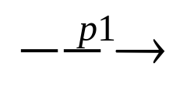
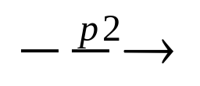
Relationship:
The relationship depends on whether or not k is an intermediate vertex of path p.
If k is not an intermediate vertex of path p, then all intermediate vertices of path p are in the set {1,2,…,k-1}. Thus, a shortest path from vertex i to vertex j with all intermediate vertices in the set {1,2,…,k-1} is also a shortest path from i to j with all intermediate vertices in the set {1,2,…,k}.
If k is an intermediate vertex of path p,then we break p down into i k j as shown Figure 2.p1 is a shortest path from i to k with all intermediate vertices in the set {1,2,…,k-1}, so as p2.

Slide 6
All intermediate vertices in {1,2,…,k-1}
p1
k
p2
i
j
P:all intermediate vertices in {1,2,…,k}
Figure 2. Path p is a shortest path from vertex i to vertex j,and
k is the highest-numbered intermediate vertex of p. Path p1,
the portion of path p from vertex i to vertex k,has all intermediate
vertices in the set {1,2,…,k-1}.The same holds for path p2 from
vertex k to vertex j.

Slide 7




A recursive solution to the all-pairs shortest paths problem:
Let d_{ij}^{(k)} be the weight of a shortest path from vertex i to vertex j with all intermediate vertices in the set {1,2,…,k}. A recursive definition is given by
d_{ij}^{(k)}= w_{ij} if k=0,
min(d_{ij}^{(k-1)},d_{ik}^{(k-1)}+d_{kj}^{(k-1)}) if k 1.
The matrix D^{(n)}=(d_{ij}^{(n)}) gives the final answer-d_{ij}^{(n)}= for all i,j V-because all intermediate vertices are in the set {1,2,…,n}.

Slide 8
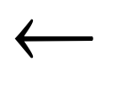
Computing the shortest-path weights bottom up:
FLOYD-WARSHALL(W)
n rows[W]
D⁽⁰⁾ W
for k 1 to n
do for i 1 to n
do for j 1 to n
d_{ij}^{(k)} min(d_{ij}^{(k-1)},d_{ik}^{(k-1)}+d_{kj}^{(k-1)})
return D^{(n)}

Slide 9
Example:
Figure 3
2
4
3
1
3
8
1
-4
-5
7
2
5
4
6

Slide 10
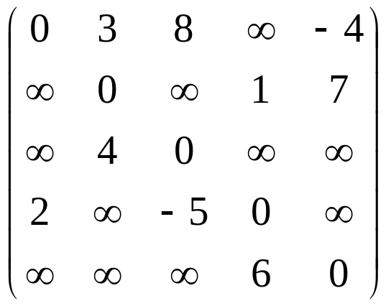
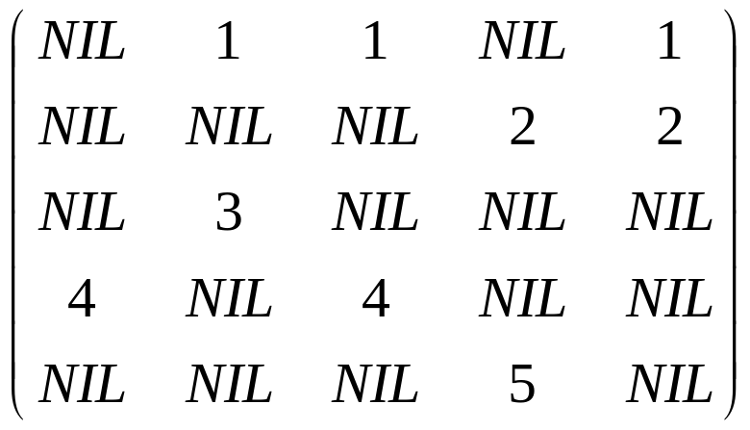

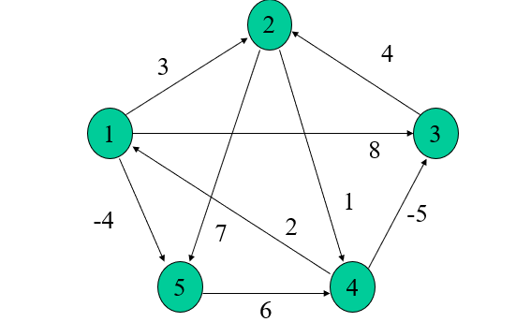
min(d_{ij}(k-1),d_{ik}(k-1)+d_{kj}(k-1))
D(0)=
(0)=

Slide 11
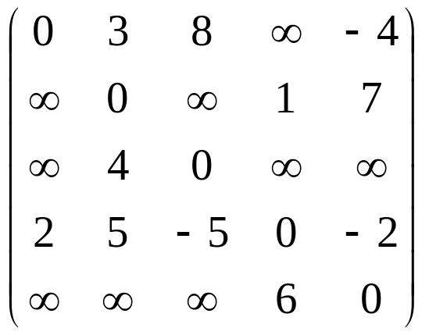
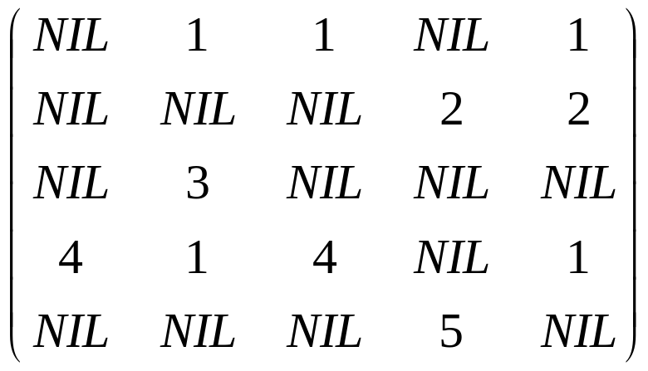
min(d_{ij}(k-1),d_{ik}(k-1)+d_{kj}(k-1))
D(0)=
min( D0[4,2] , D0[4,1] + D0[1,2])
1 2 3 4 5
D(1)=
(1)=

Slide 12
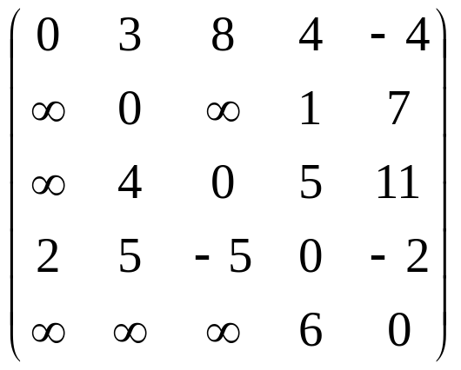
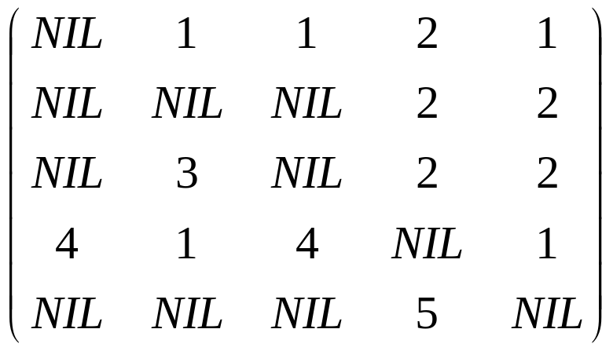
min(d_{ij}(k-1),d_{ik}(k-1)+d_{kj}(k-1))
D(1)=
min( D1[1,4] , D1[1,2] + D1 [2,4])
D(2)=
(2)=

Slide 13
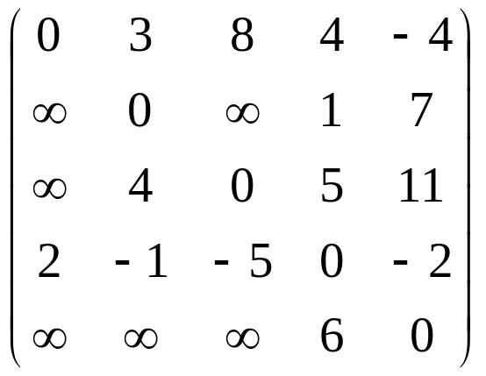

min(d_{ij}(k-1),d_{ik}(k-1)+d_{kj}(k-1))
D(2)=
D(3)=
(3)=

Slide 14
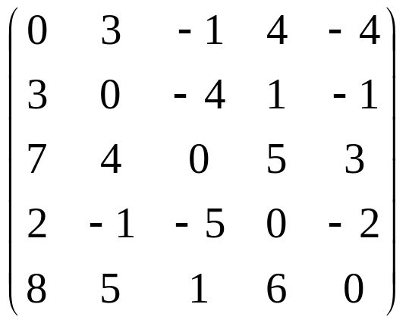
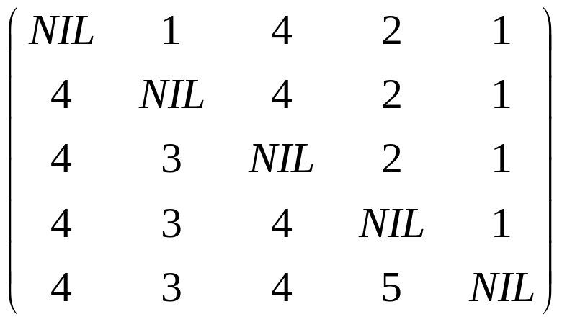
min(d_{ij}(k-1),d_{ik}(k-1)+d_{kj}(k-1))
D(3)=
D(4)=
(4)=

Slide 15
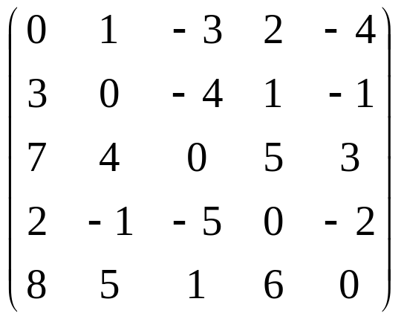
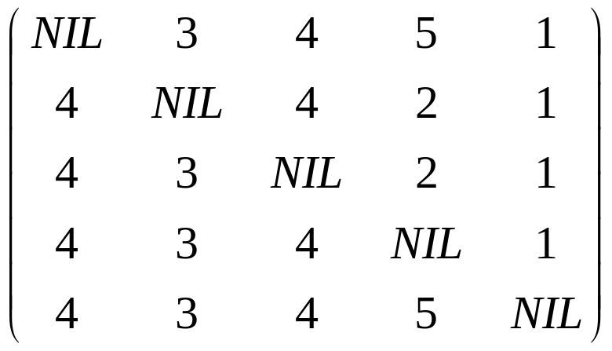
min(d_{ij}(k-1),d_{ik}(k-1)+d_{kj}(k-1))
D(4)=
D(5)=
(5)=

